Slide 1
NIFA’s role in Catalyzing Transformative Research on Animal Genome to Phenome
Parag R. Chitnis

Slide 2
NIFA- An Introduction
Lead federal agency providing extramural funding for food and agricultural sciences
Tripartite mission: research, extension, and education
Funding opportunities exist for each of these three mission areas
NIFA funding
1.5B budget
Competitive and capacity funds
Mission
invest in and advance agricultural research, education, and extension to solve societal challenges.

Slide 3
NIFA funding for Animal Genomics and Breeding
Farm Animals for Food Production
Aquaculture
Capacity Funds ($9M in 2014)
Multistate research projects (foster collaborations)
Hatch Projects (state identified priorities)
AFRI and other competitive programs ($12M in 2014)
Foundational Grants ($500K)
Food Security Challenge Area ( > $1 M)
Aquaculture programs (2-300K)
Interagency programs

Slide 4
President’s Proposed

Slide 5
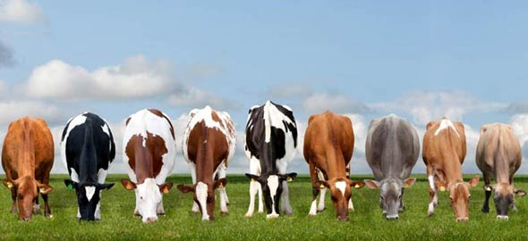
Genome to Phenome: Opportunities
Rules of Life- Translating genome to decipher phenome
Applications- Accelerated and Predictive Breeding

Slide 6
Genome to Phenome: Challenges
Theoretical underpinning
Technologies High throughput phenotyping
Data Resources Cyberphysical systems
Data Analytics Predictive algorithms

Slide 7
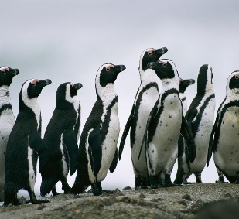
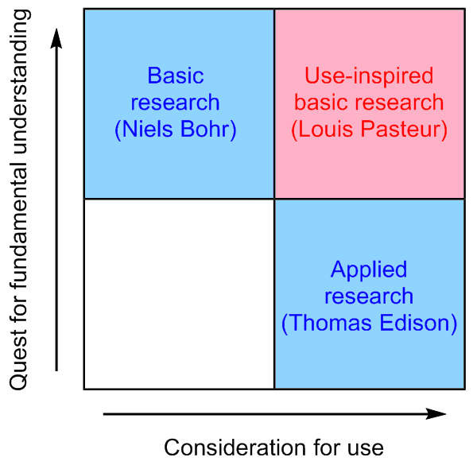
Genome to Phenome: Interagency Collaboration
NSF
NIFA
NIH
Industry

Slide 8
Learning from other initiatives
Arabidopsis Functional Genomics
NSF, DFG, BBSRC, and others
National Plant Genome Initiative
NSF, NIFA, ARS, DOE
Yeast Synthetic Genome
NSF, China MoST, BBSRC, Singapore, Australia, and others
International Wheat Yield Partnership
BBSRC, CIMMYT, USAID, NIFA, SAGARPA

Slide 9
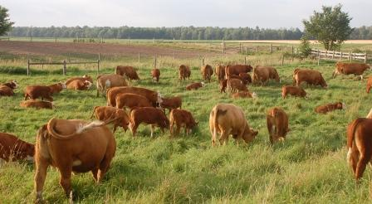
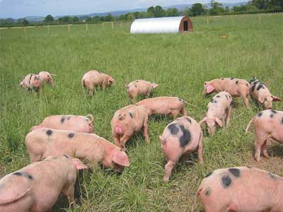
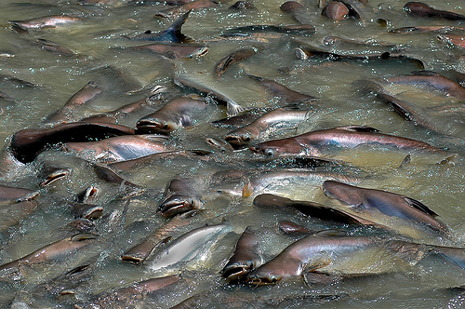
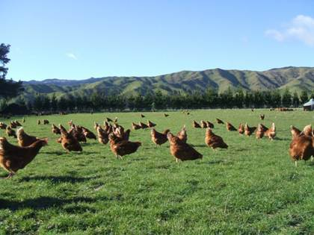
Two cents worth….
Ambitious goals
Relatable to general public
Clear milestones
measurable
Economic impacts
Potential for breakthroughs
Stakeholder buy-in
Ag. Experiment Stations
Commodity groups and boards
Professional Societies

